Slide 1
Captcha-Mask SDP 2021 PDR
By Team 24
Faculty Advisor: Professor Dennis Goeckel

Slide 2
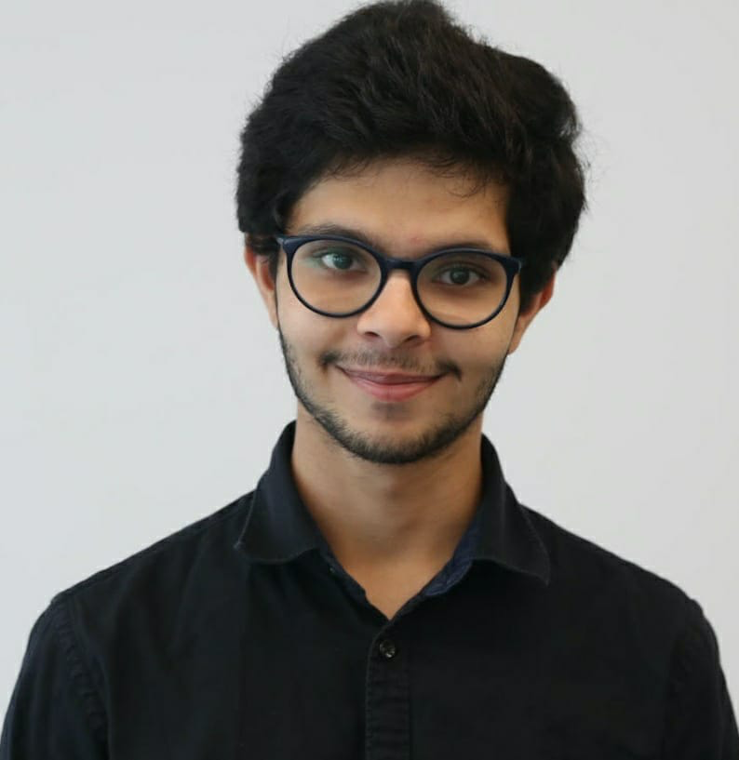
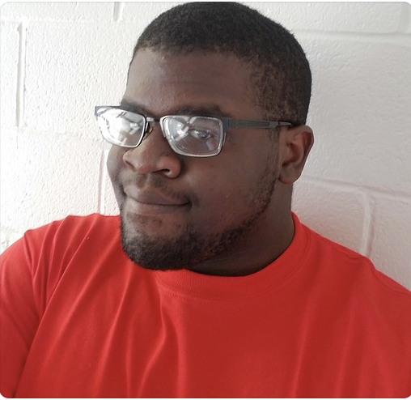
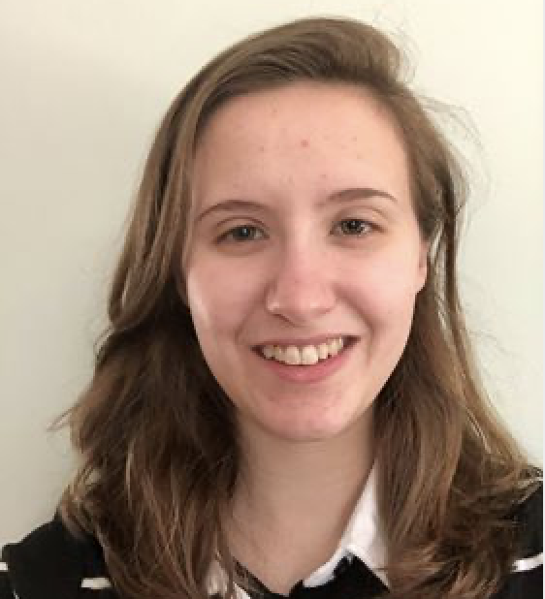

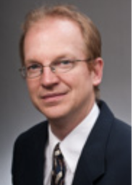
Team 24
Rushiv Arora
CS/CompE
Chidinma Ejiofor
CompE
Jennifer Gosselin
EE
Hirad Tabatabaei
EE
Professor Dennis Goeckel
Faculty Advisor

Slide 3





Problem Statement
“With the onset of the Covid-19 pandemic, the world was forced to wear face masks in public, highlighting an issue faced by professionals who wear masks for their jobs: muffled voices and incomprehensible speech, especially for those with hearing impairments.”
“Captcha-Mask will be a lightweight speech-to-text system that rests in custom masks and prints audio-to-text on screens to better help people, especially those with hearing impairments, understand their mask wearing counterparts.”
Can you hear me?

Slide 4
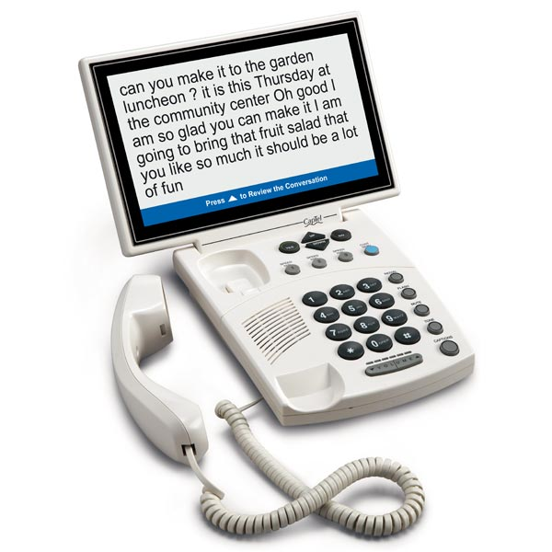
Survey Of Competing solutions
There are other devices out there which can be used for closed captioning and/or helping hearing impaired people. However, each of products have their own backdrops:
Captioned Telephone¹:
Product with a screen displaying words during a phone call. Used primarily by hearing impaired people.
Problems:
Not Portable
Not adjustable to the speed of the speaker
Notes:
https://www.firststreetonline.com/shop.axd/ProductDetails?ITEM_NO=16200&gclid=EAIaIQobChMI8afJ5rn26wIVCuKzCh2ergYZEAQYByABEgKik_D_BwE&fbclid=IwAR1AZVHsgG_wXL0RY-LTG8woD85gA1jDyoRoo3KOEJaI7c-m_eUSqNDFl9g

Slide 5
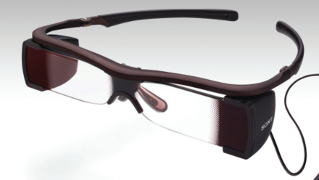
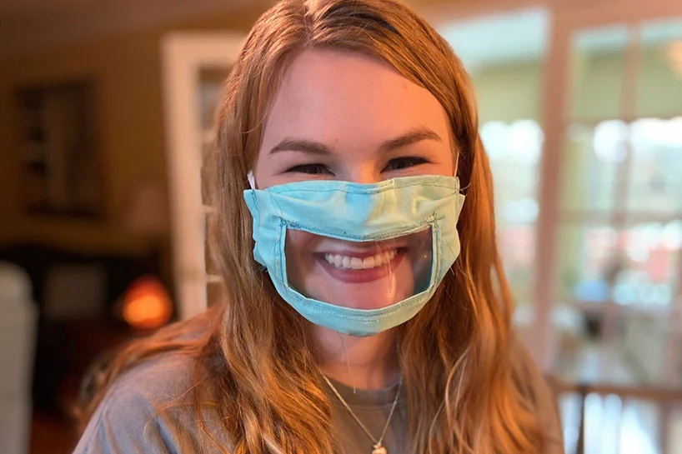
Survey Of Competing solutions
2. Captioned Glasses for Movies²:
Problems:
Captions are too small to read
The battery life is low
3. Transparent Masks³:
Problem:
Lip reading is an ineffective form of communicating and many hearing impaired/deaf people cannot read lips
Notes:
https://www.qsc.com/cinema/products/accessibility-solutions/usl-cch-100/?fbclid=IwAR388d8UNcA0GwJmpXFMIxWfbNsenGwsez5eldwyUm66oc_i9uhs4MK-70c
https://ifmyhandscouldspeak.wordpress.com/common-myths-about-deaf-people-and-the-truth/

Slide 6






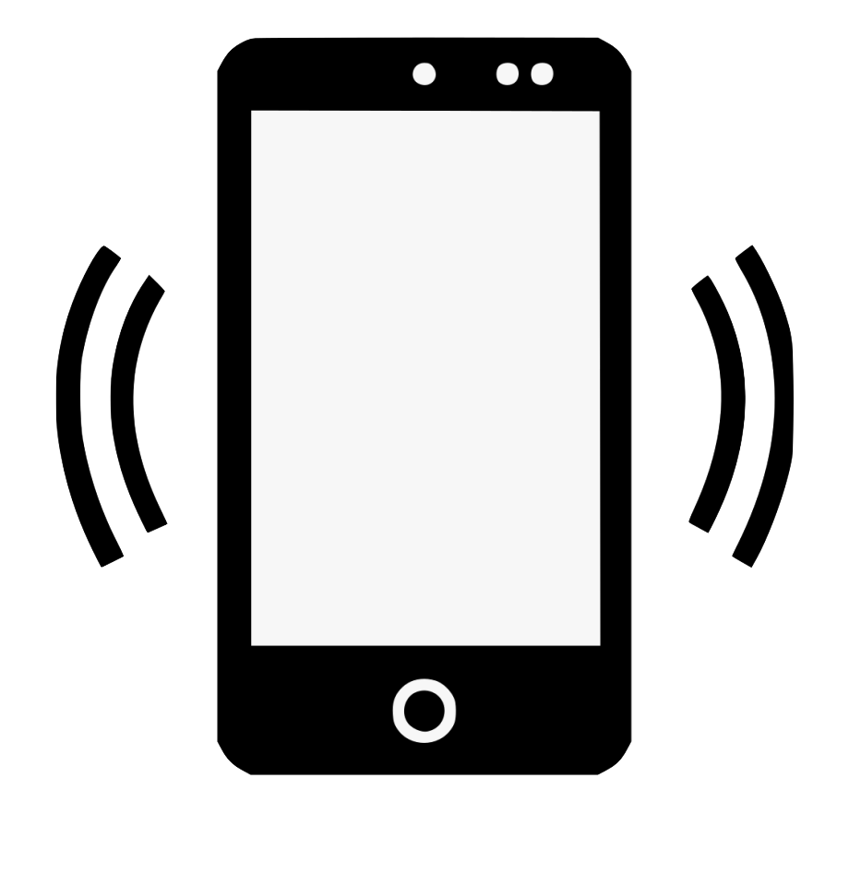
Our Solution: Captcha-Mask
Cloud
World
World
Hello
Hello
6 ft
Notes:
Ask Professor/Team on which alternate image is better

Slide 7
System Specifications
Performance
Battery Life of at least 1 hour on full charge
Power up in 3 seconds
Power down in 3 seconds
Features
Can capture 80 wpm or more ⁴
Bluetooth Connectivity
Text readable from 6ft
Cost
Project Cost [$262]
Production Cost [$25.89]
Weight[Limit 100 Grams]
*Cost per 10,000 units
Notes:
4. Dom Barnard. “Average Speaking Rate and Words per Minute.” Virtualspeech.Com, VirtualSpeech, 20 Jan. 2018,

Slide 8
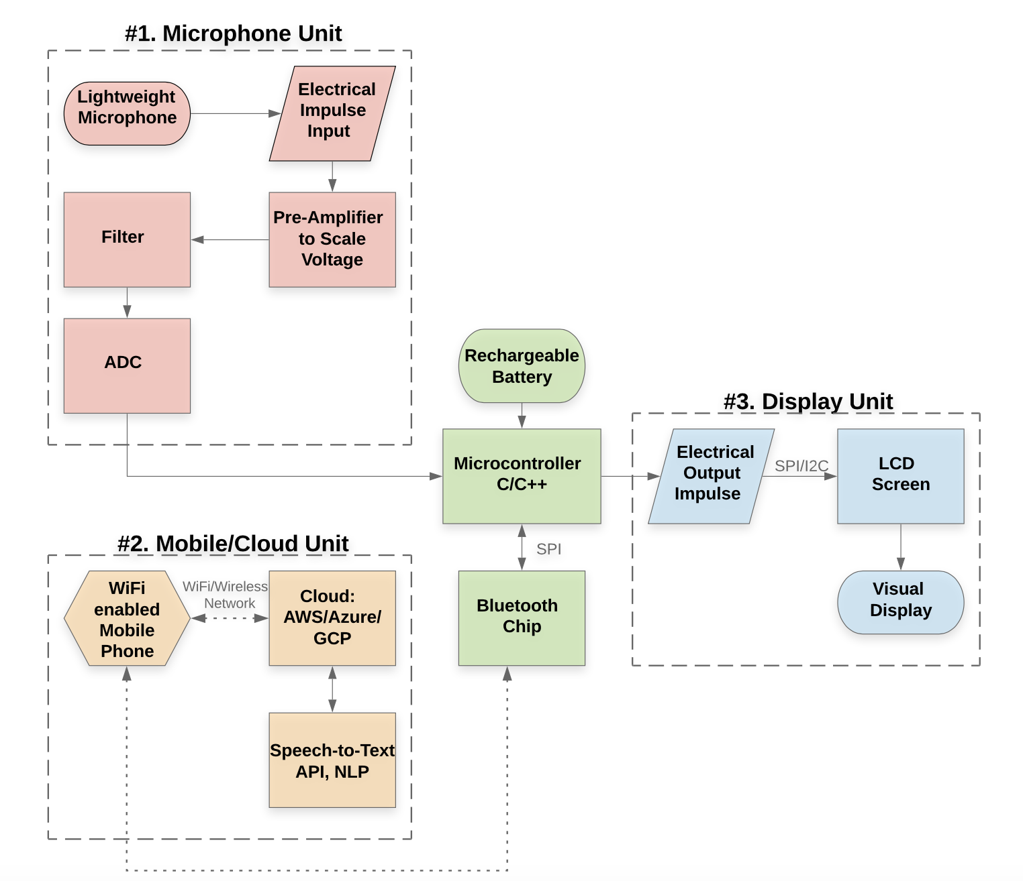


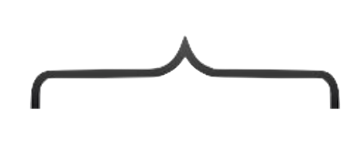

Preliminary Design/Block Diagram
Hardware located on the inside of the mask
Located on the inside of the mask
Hardware located on the outside of the mask
Mobile Phone located within 6 feet of the person. Server located remotely on the US East Coast
Notes:
I am not satisfied with the size of the block diagram, as Prof Goeckel for input - Rushiv

Slide 9
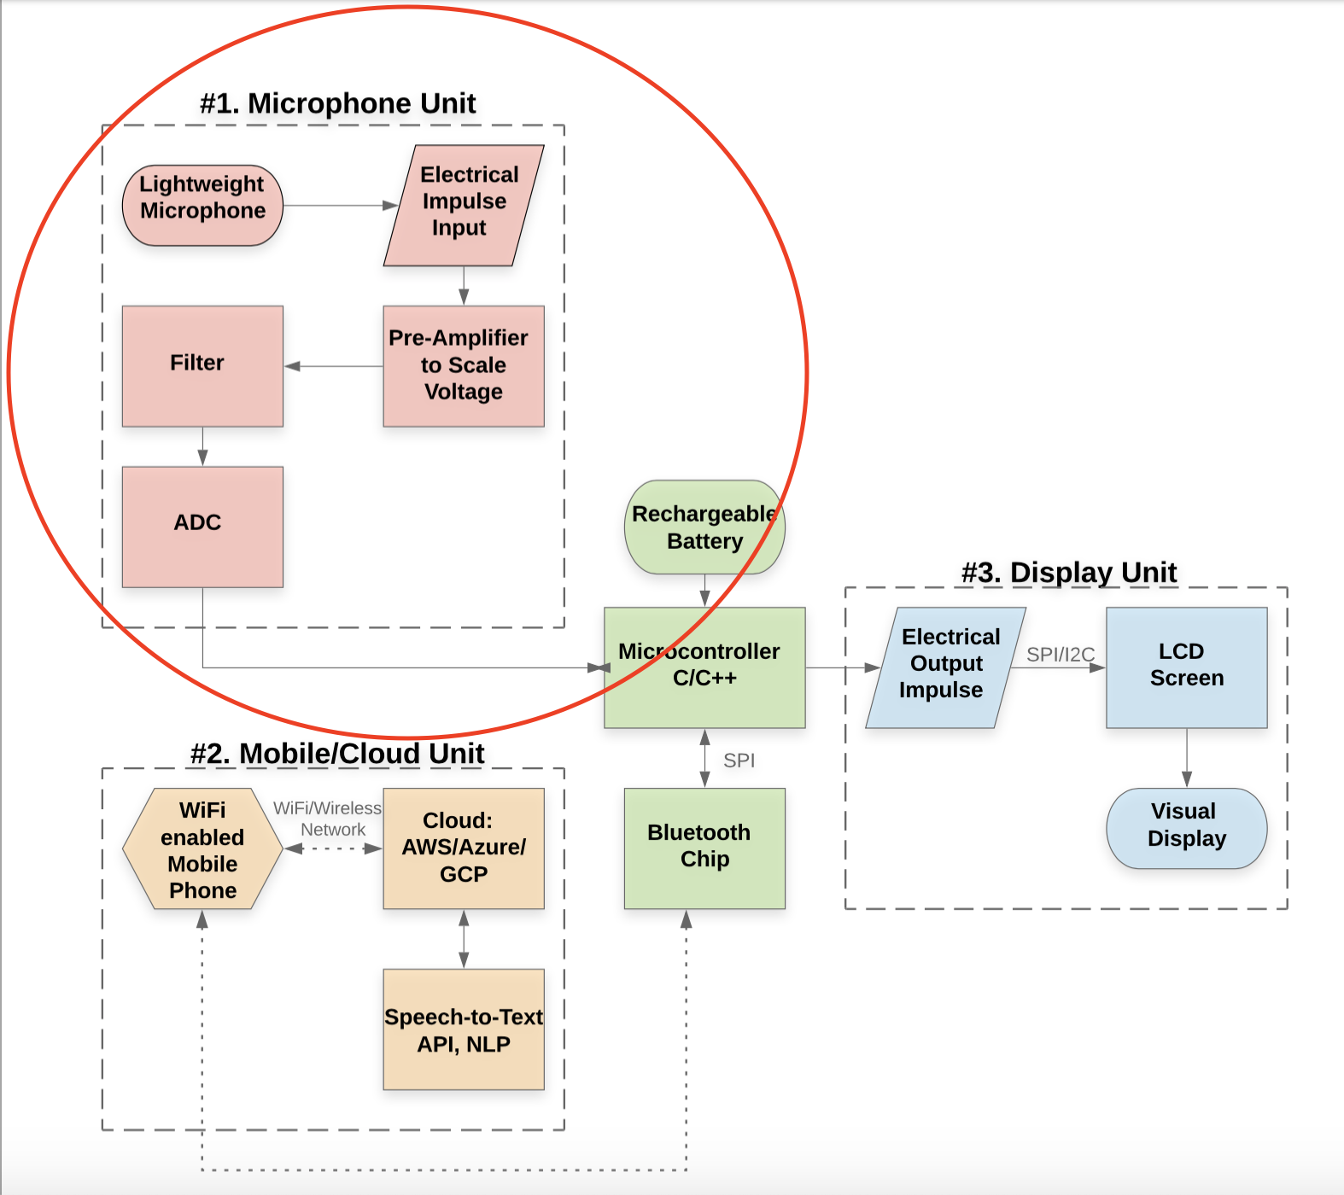
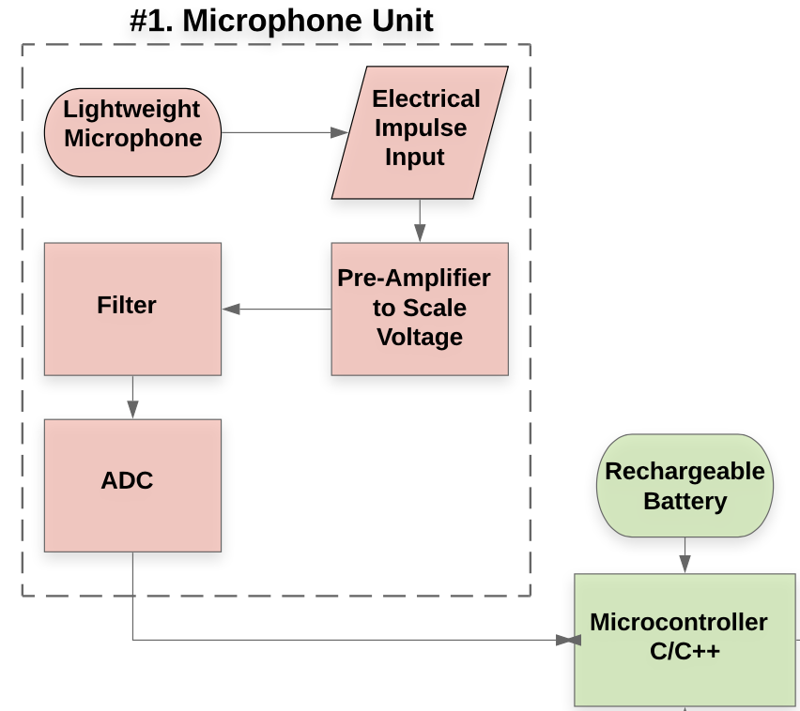


Unit 1: The Microphone Unit
The PCB design will consists of the component shown in this unit.
The system will weigh less than 100 grams.
The system will be powered by a rechargeable lithium-ion⁵ battery. Minimum battery life of 1-hour
Notes:
5. Alternatives include Cobalt free batteries and Sand batteries. But they heat up more and drive the price.

Slide 10
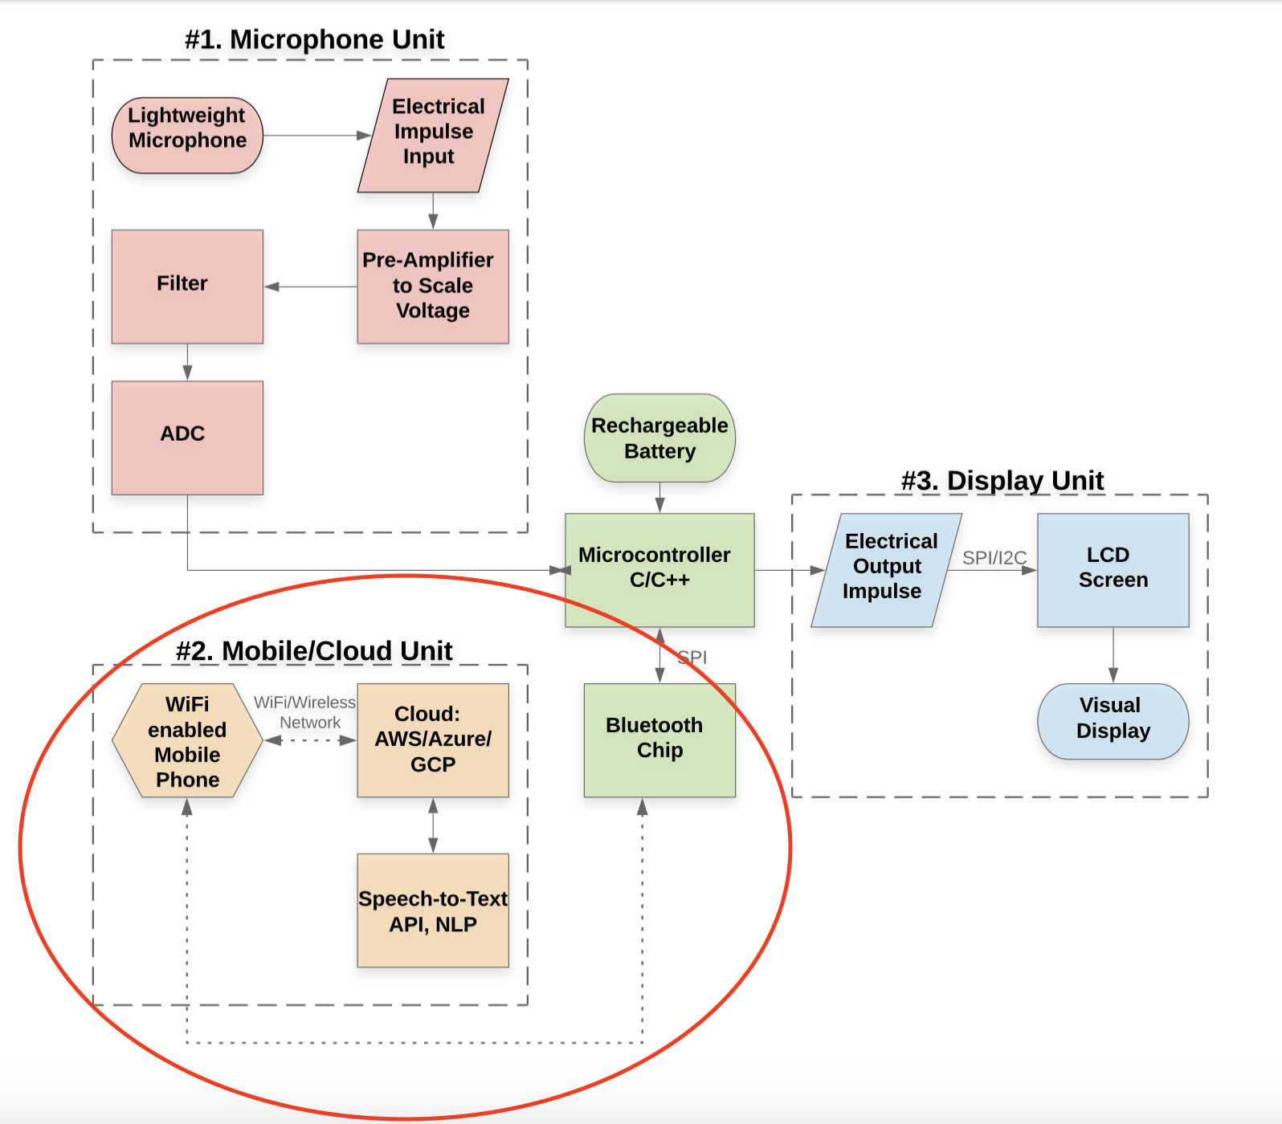

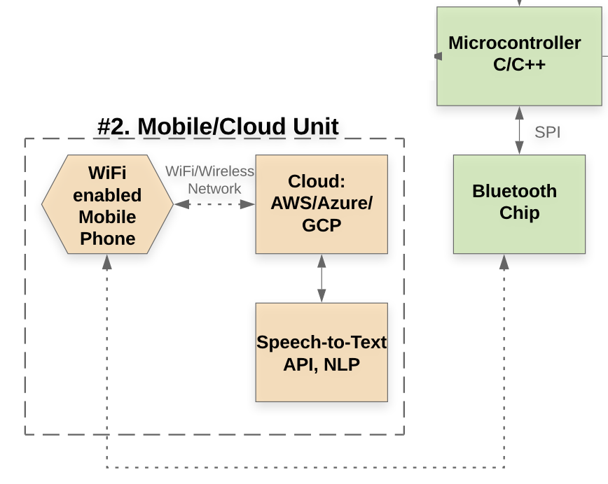


Unit 2: The Mobile/Cloud Unit
A mobile phone will send the processed speech file to a server over a bidirectional WiFi network.
The server will be Linux based with a Python and C/C++ environment. The Speech-to- text API will be hosted on the server. Natural Language Processing will post-process the text
Bluetooth chip will use bluetooth 4.2 or 5.0 for connectivity with all modern mobiles ⁶.
Notes:
6. https://www.thesouthafrican.com/technology/bluetooth-5-versus-4-specs-differences/

Slide 11
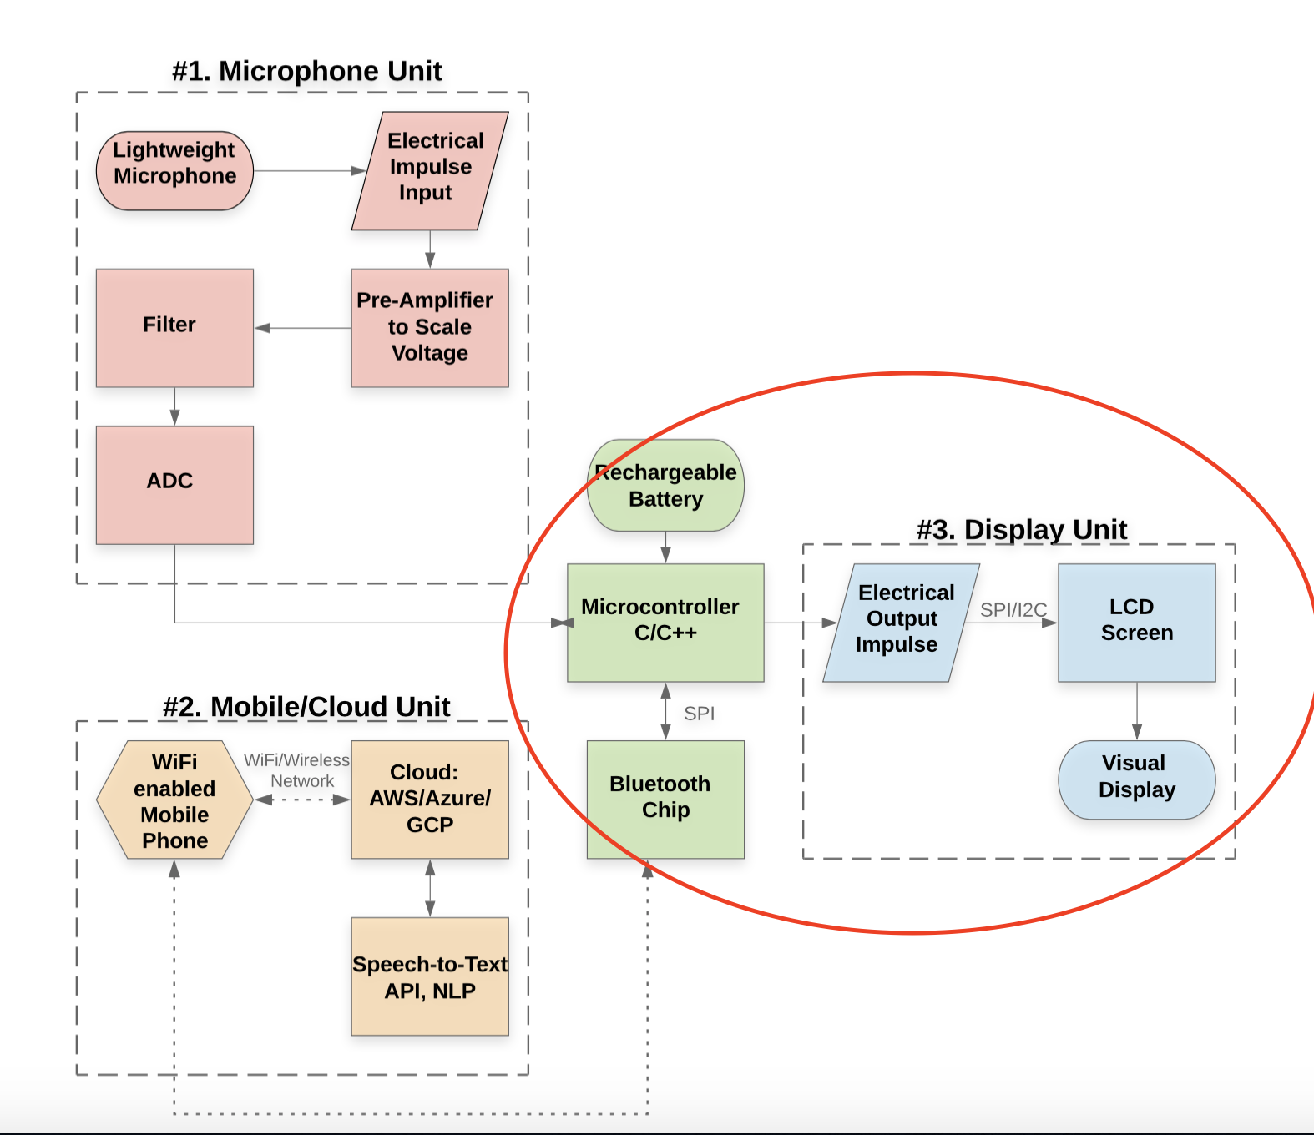

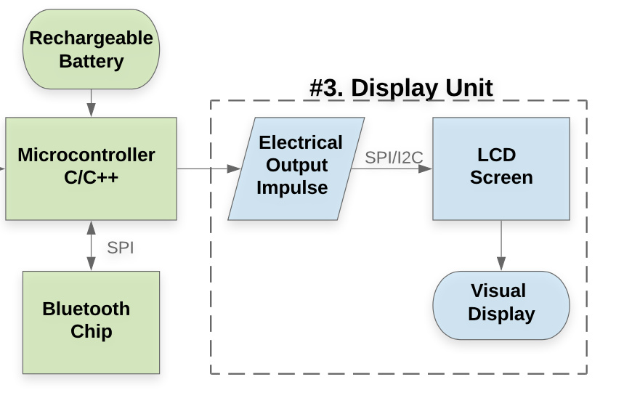
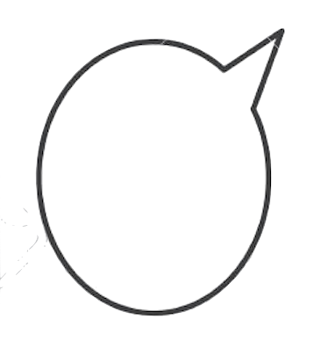
Unit 3: The Display Unit
The LCD/LED screen must have a minimum font size of 25 pts ⁸ to be visible from 5 feet. The speed of the text will be adjustable to at least 80 words per minute⁹.
Microcontroller must be C/C++ based and have at least 6 KB RAM ⁷
The Microcontroller must be SPI and I2C compatible
Notes:
7. The Sparkfun transparent LCD screen works only with microcontrollers having a minimum of 5500 Bytes
of RAM. Look at the datasheet: https://www.digikey.com/product-detail/en/sparkfun-electronics/LCD-15079/1568-LCD-15079-ND/9953913?utm_adgroup=Evaluation%20Boards%20-%20Expansion%20Boards%2C%20Daughter%20Cards&utm_source=google&utm_medium=cpc&utm_campaign=Shopping_Product_Development%20Boards%2C%20Kits%2C%20Programmers&utm_term=&utm_content=Evaluation%20Boards%20-%20Expansion%20Boards%2C%20Daughter%20Cards&gclid=CjwKCAjw5Kv7BRBSEiwAXGDElQhs4e7W1qfTwrSYSukGTB9eB3NVdq4i9hvr1jpR1Nmv8a59ktaZcBoC62AQAvD_BwE
8. For 5 feet the minimum average font size of comfort is 25-30 pts. Link:
https://www.sciencebuddies.org/science-fair-projects/science-fair/display-board-fonts
9. Dom Barnard. “Average Speaking Rate and Words per Minute.” Virtualspeech.Com, VirtualSpeech, 20 Jan. 2018,

Slide 12
Significant Custom Hardware
Designing the PCB for the microphone unit and central unit, which consists of the lightweight microphone, preamplifier, filter(s), analog to digital converter, microcontroller, and bluetooth chip.
The PCB will process, sample, and transmit the speaker’s voice over a bluetooth network.
The PCB will communicate with an LED/LCD as well as a bluetooth chip using SPI or I2C.
The entire PCB system must weigh less than the weight stated in the system specs

Slide 13
Cost Analysis Part 1
Item | Quantity | Cost [$] Per Unit | Project Cost [$]
Fabric | 2 | .75 | 10
Elastic | 2 | .65 | 8
Bluetooth Receiver | 1 | 1.75 | 10
ADC | 1 | .75 | 3
Preamplifier | 1 | .25 | 3
Filter | 1 | .50 | 8
Lithium-Ion Battery | 1 | 3.5 | 35
Microphone | 1 | .85 | 10
LED/LCD Screen | 1 | 4 | 50

Slide 14
Cost Analysis Part 2
Item | Quantity | Cost [$] Per Unit | Project Cost [$]
Microcontroller | 1 | .85 | 50
Cloud Service [ 60 min ] | 1 | 1.44 | Variable
3D Printed Enclosure | 1 | .20 | Free
LCD Protector | 1 | .4 | Free
PCB | 1 | 10 | 75
Total Production Cost* [$] | 25.89
Total Project Cost [$] | 262
*Production cost is per 10,000 pieces. Sources: Digikey and Alibaba

Slide 15
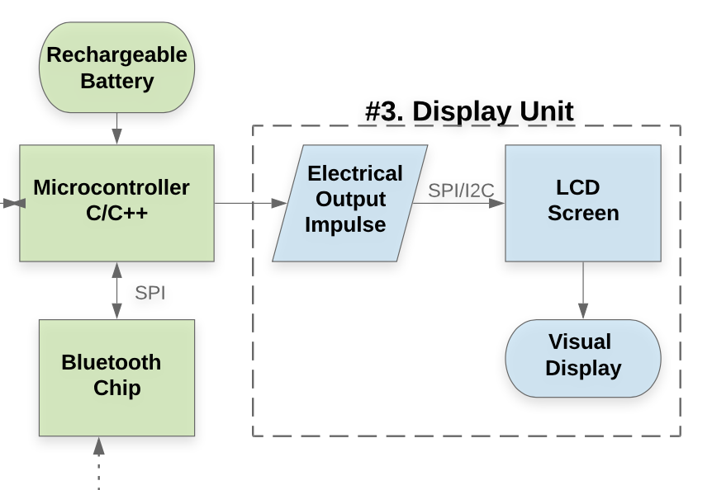
MDR Deliverables
By MDR the three subsystems will be complete
The Microphone Unit
The Mobile/Cloud Unit
The Display
Rushiv
Selecting appropriate cloud platform
Host a Speech-to-Text API on the cloud and apply Natural Language Processing for post-processing
Adjust the parameters to avoid over/under fitting
Connect a Mobile Device to the server
Jennifer
Selecting electrical components
Scaling the electrical impulse from microphone
Hirad
Selecting electrical components
Filter Design
Converting analog to digital signal
Rushiv/ Chidinma
Selecting Microcontroller
Chidinma
Select appropriate LED/LCD screen
Print messages on the LED/LCD screen Adjust the speed and font to 80 wpm and 25+ pt.
Set up bluetooth connections and run dummy tests from a mobile phone

Slide 16
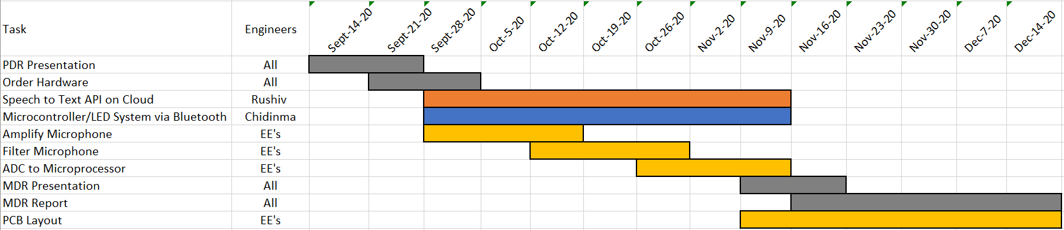
Project Management
Team Coordinator: Rushiv Arora
Altium Lead: Jennifer Gosselin
Budget Management Lead: Chidinma Ejiofor

Slide 17

Thank you!
Questions?

